Slide 1


Naan Mudhalvan -NM1009 Generative AI for Engineering
PROJECT TITLE : SPEECH RECOGNITION USING (RNN)
Presented By :
Name : SHARMILA R
Reg No : 730321104055
Department : Computer Science and Engineering
Date:07.05.2024
Venue: IIT Remote Center

Slide 2


AGENDA :
Problem Statement
Project Overview
End Users
Our Solution
Special Features
Modelling Approach
Results
Conclusion

Slide 3

PROBLEM STATEMENT :
Data Acquisition and Preprocessing: The code downloads and preprocesses the LJ Speech dataset. It reads audio files, converts them into spectrograms, and normalizes them for training.
Model Definition: The model architecture needs to be defined for training. This includes defining the layers for processing the spectrograms and predicting the text transcription.
Training and Validation: The training and validation datasets are prepared from the LJ Speech dataset. The model is trained on the training dataset and validated on the validation dataset.
Evaluation: Once trained, the model's performance needs to be evaluated on unseen data to assess its accuracy in transcribing speech.

Slide 4

PROJECT OVERVIEW :
Objective: Develop an ASR system using Recurrent Neural Networks (RNNs), particularly Long Short-Term Memory (LSTM) cells, for temporal sequence modeling.
Dataset: Utilize the LJ Speech dataset, containing speech audio recordings paired with text transcriptions.
Model Architecture: Design an RNN-based architecture with input layers for spectrogram data, LSTM layers for sequence modeling, and a dense layer for transcription prediction.
Data Preprocessing: Convert audio files into spectrograms and tokenize text transcriptions for model input.
Model Training: Train the RNN model on preprocessed data, optimizing for transcription accuracy using evaluation metrics like Word Error Rate (WER).

Slide 5

WHO ARE THE END USERS?
Consumers
Professionals
Accessibility Users
Language Learners
Researchers and Developers
Enterprises
Government and Defense

Slide 6

YOUR SOLUTION AND ITS VALUE PROPOSITION
Accuracy and Robustness: RNN models, with their ability to capture temporal dependencies in sequential data, excel in accurately transcribing speech into text.
Adaptability to Context: RNN models inherently possess a dynamic nature that allows them to adapt to varying contexts and input sequences.
Real-time Processing: The recurrent nature of RNN models enables them to process input sequences in real-time, making them suitable for applications requiring low latency, such as live speech transcription, voice commands in interactive systems, and real-time translation services.

Slide 7
SPECIAL FEATURES :
Speaker Diarization: Implementing speaker diarization enables the system to recognize and differentiate between multiple speakers in a conversation or audio recording.
Keyword Spotting: Integrating keyword spotting capabilities allows the system to detect and recognize specific keywords or phrases within speech input.
Keyword Spotting: Integrating keyword spotting capabilities allows the system to detect and recognize specific keywords or phrases within speech input.
Noise Robustness: Incorporating noise robustness features enhances the system's ability to accurately transcribe speech in noisy environments or adverse acoustic conditions.

Slide 8
MODELLING :
Data Preprocessing:
Audio Processing: Convert raw audio waveforms into spectrograms or Mel-frequency cepstral coefficients (MFCCs) to represent the frequency content of the speech signal over time.
Text Preprocessing: Tokenize text transcriptions into sequences of integers or characters for model input.
Model Architecture Design:
Input Layer: Define input layers to process spectrogram/MFCC data or tokenized text sequences.
Recurrent Layers: Incorporate LSTM layers to capture temporal dependencies in speech and text sequences. Optionally, bidirectional LSTMs can be used to process input sequences in both forward and backward directions.
Dense Layers: Add dense (fully connected) layers for sequence classification or transcription prediction.
Output Layer: Use softmax activation for multi-class classification tasks (e.g., predicting characters or phonemes) or sigmoid activation for binary classification tasks (e.g., keyword spotting).
Learning Rate: Adjust the learning rate to control the step size in gradient descent optimization.
Deployment and Inference:
Deployment: Deploy the trained model as part of a speech recognition system or application, ensuring compatibility with deployment environments (e.g., cloud-based servers, mobile devices).
Inference: Use the deployed model to transcribe speech input in real-time or batch processing scenarios, generating text output based on the model's predictions.
07/05/2024 speech recognition usig rnn

Slide 9
DRAW ANY FLOW DIAGRAM OR SEQUENCE DIAGRAM

Slide 10
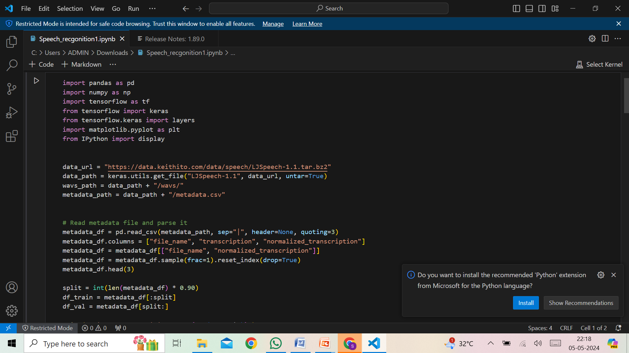
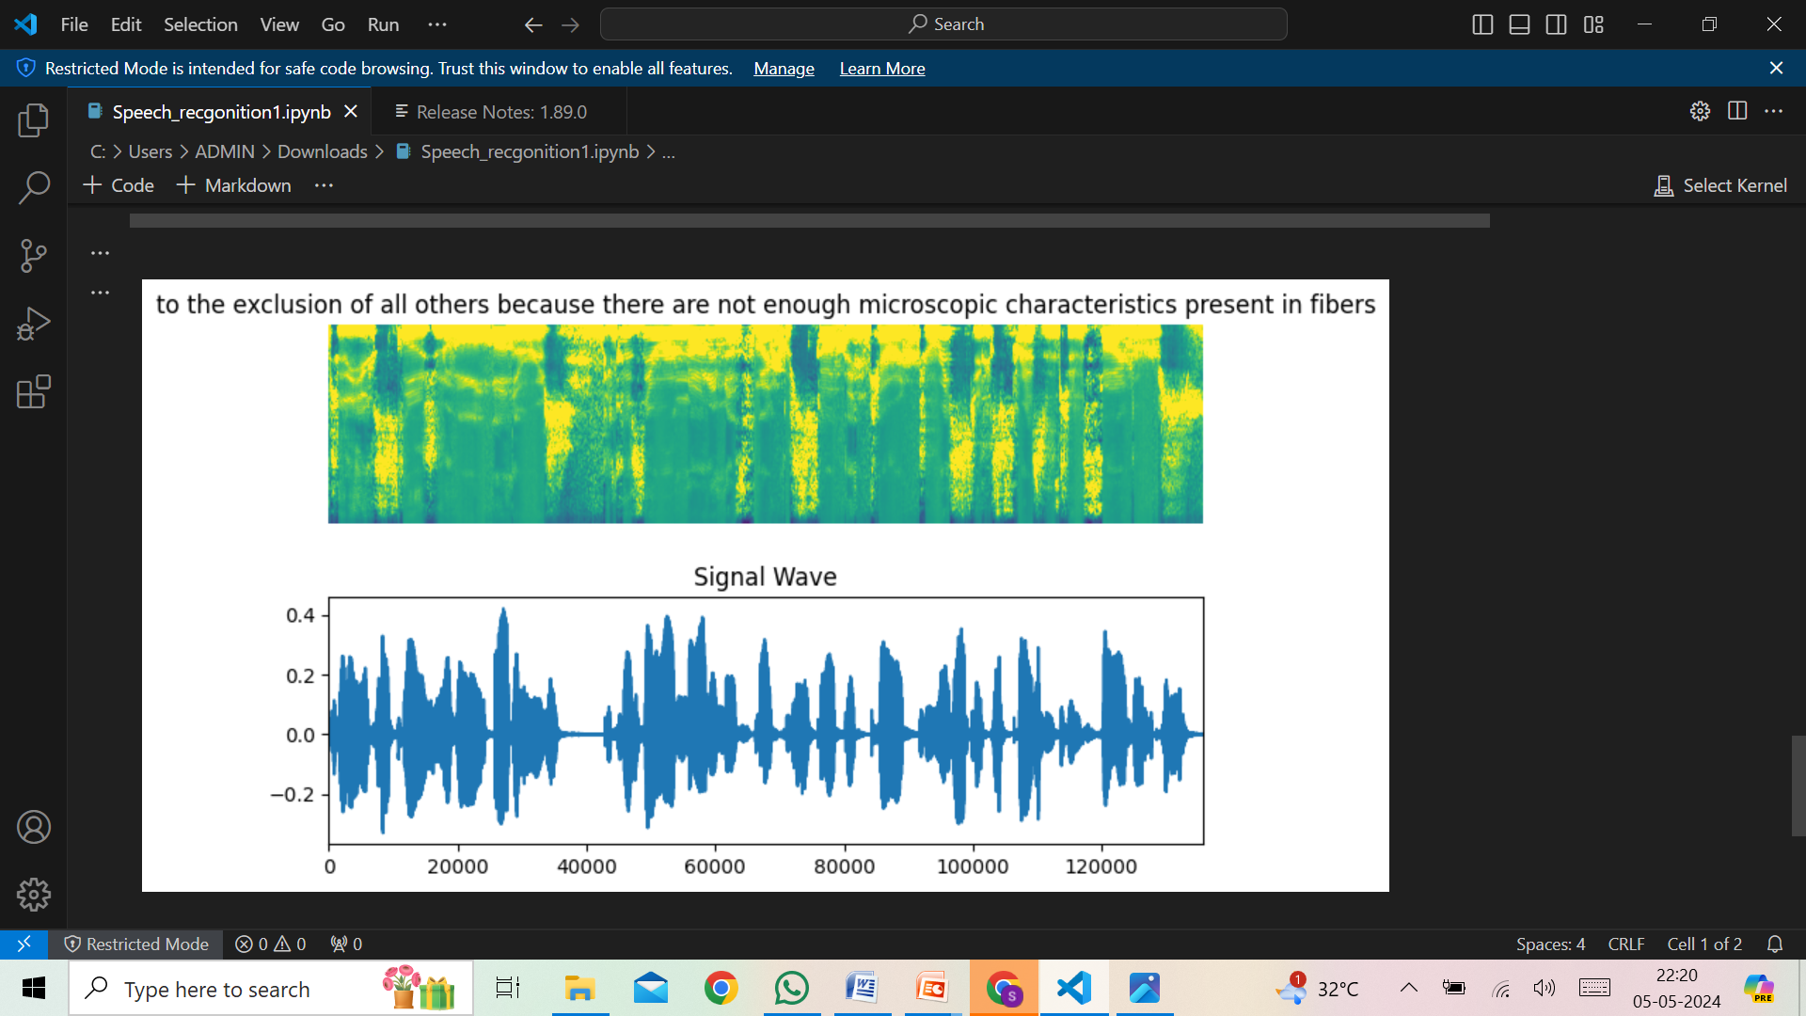
RESULTS :
INPUT CODE
OUTPUT
10

Slide 11
CONCLUSION :
In conclusion, speech recognition technology represents a pivotal advancement in human-computer interaction, offering a wide array of applications and benefits across various industries and domains.
Finally, we successfully developed the speech recognition search using the Recurrent Neural Network Algorithm.
THANK YOU

